Slide 1
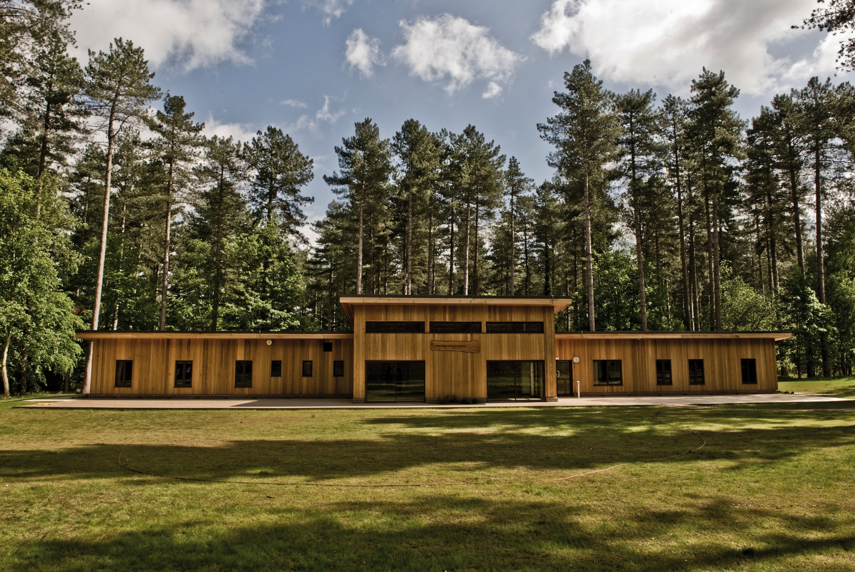

Slide 2
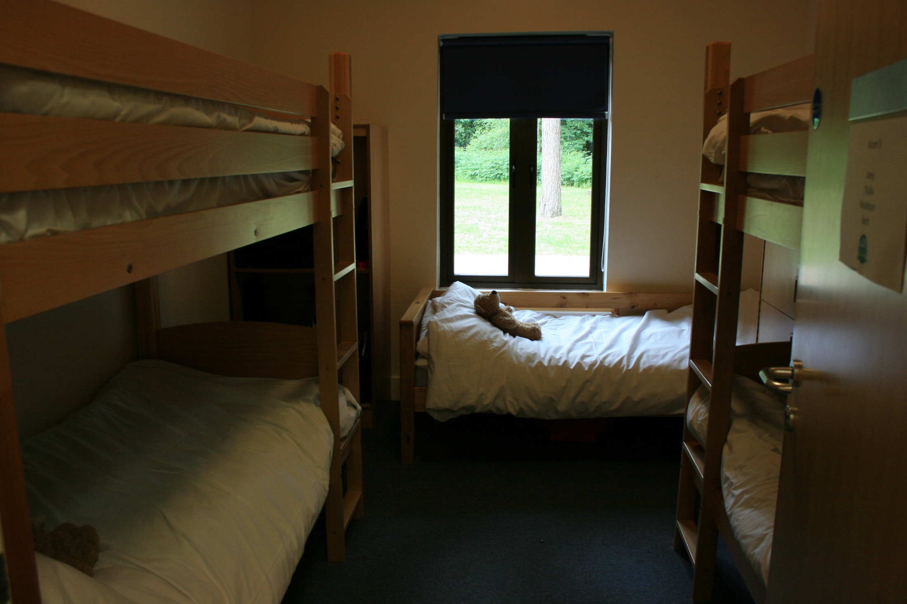

Slide 3
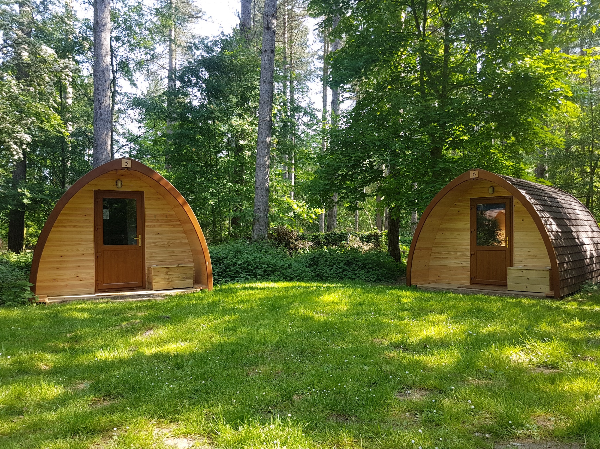

Slide 4
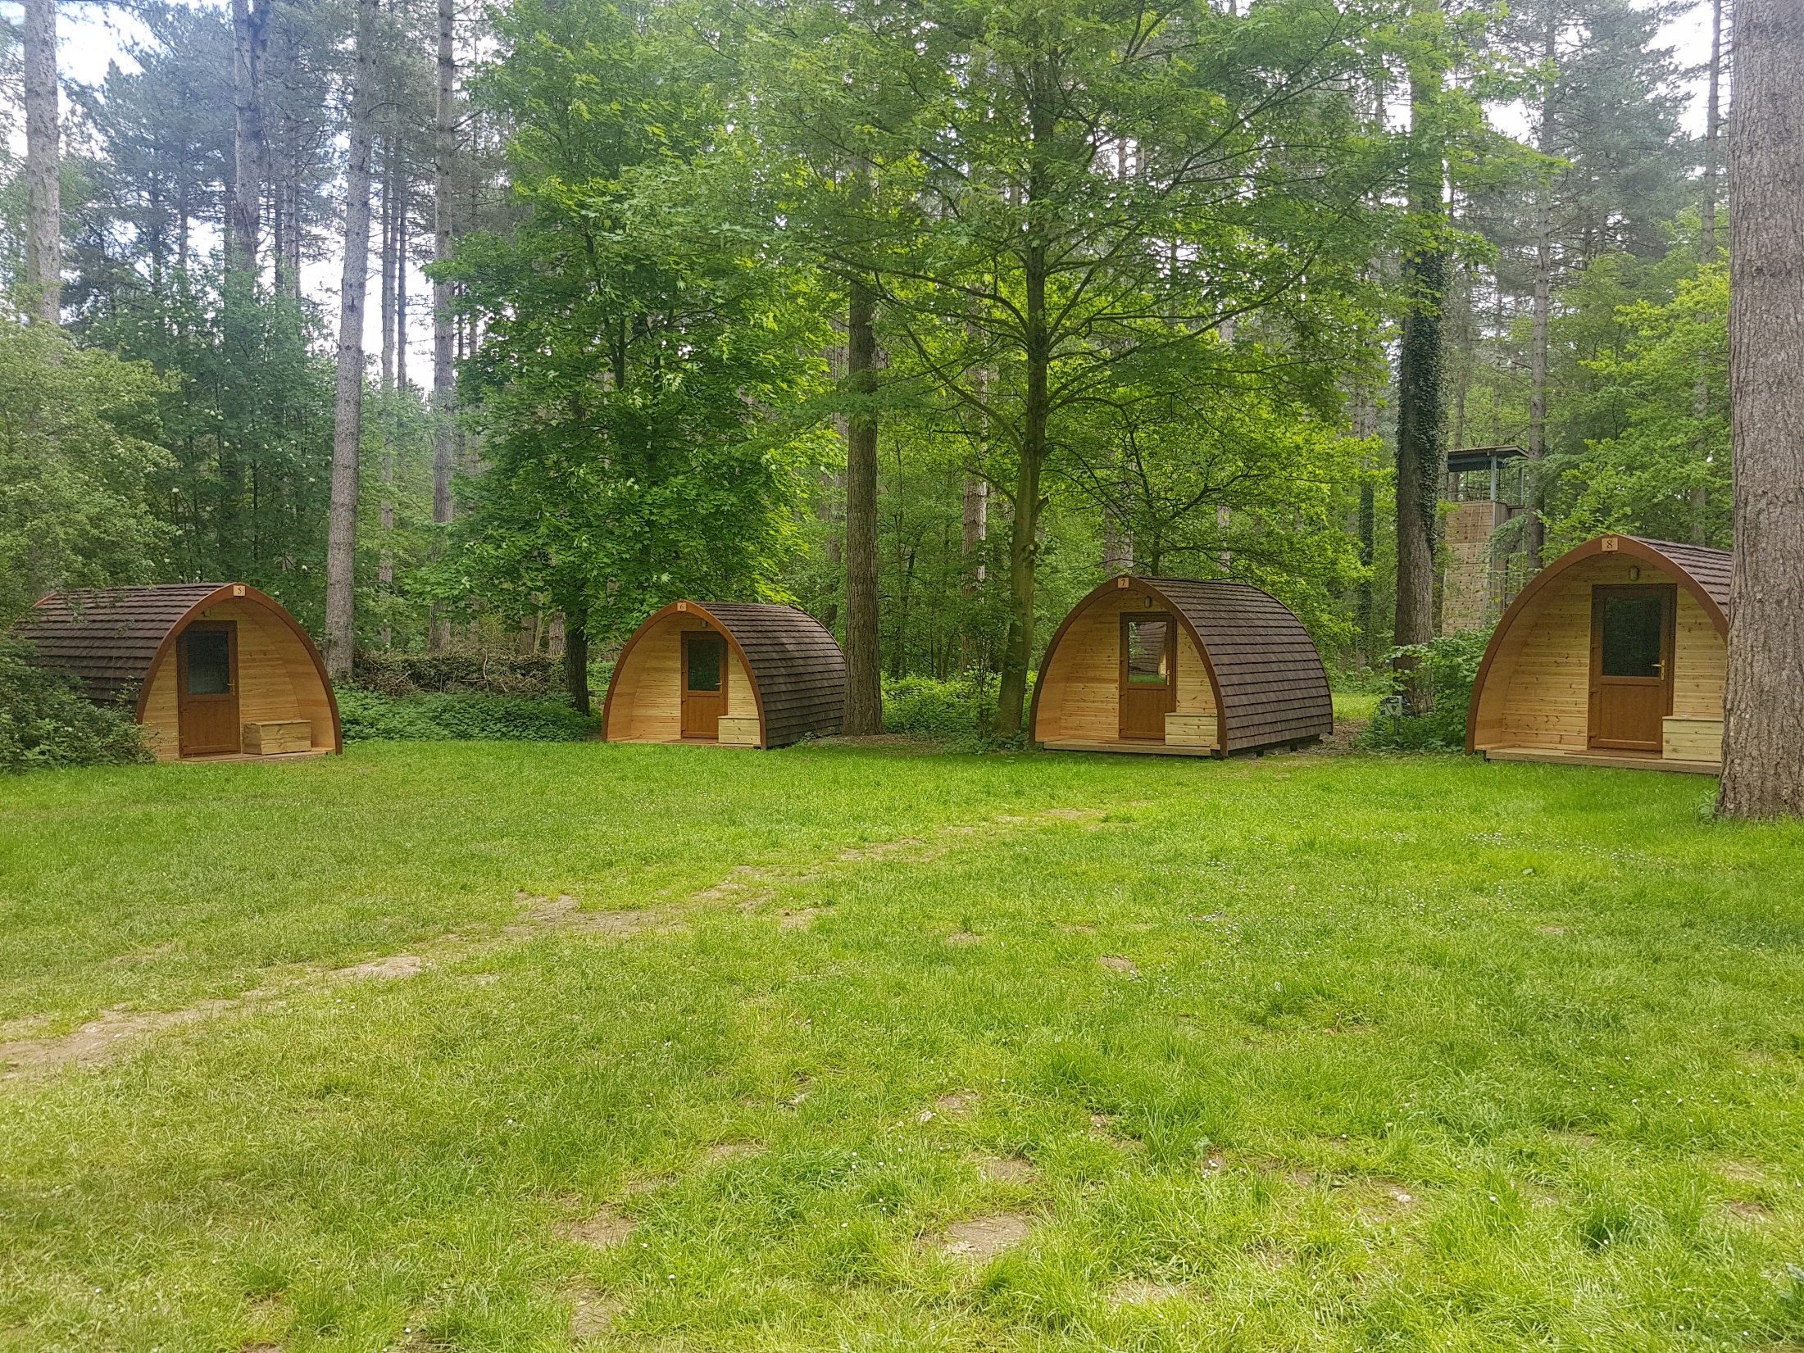

Slide 5
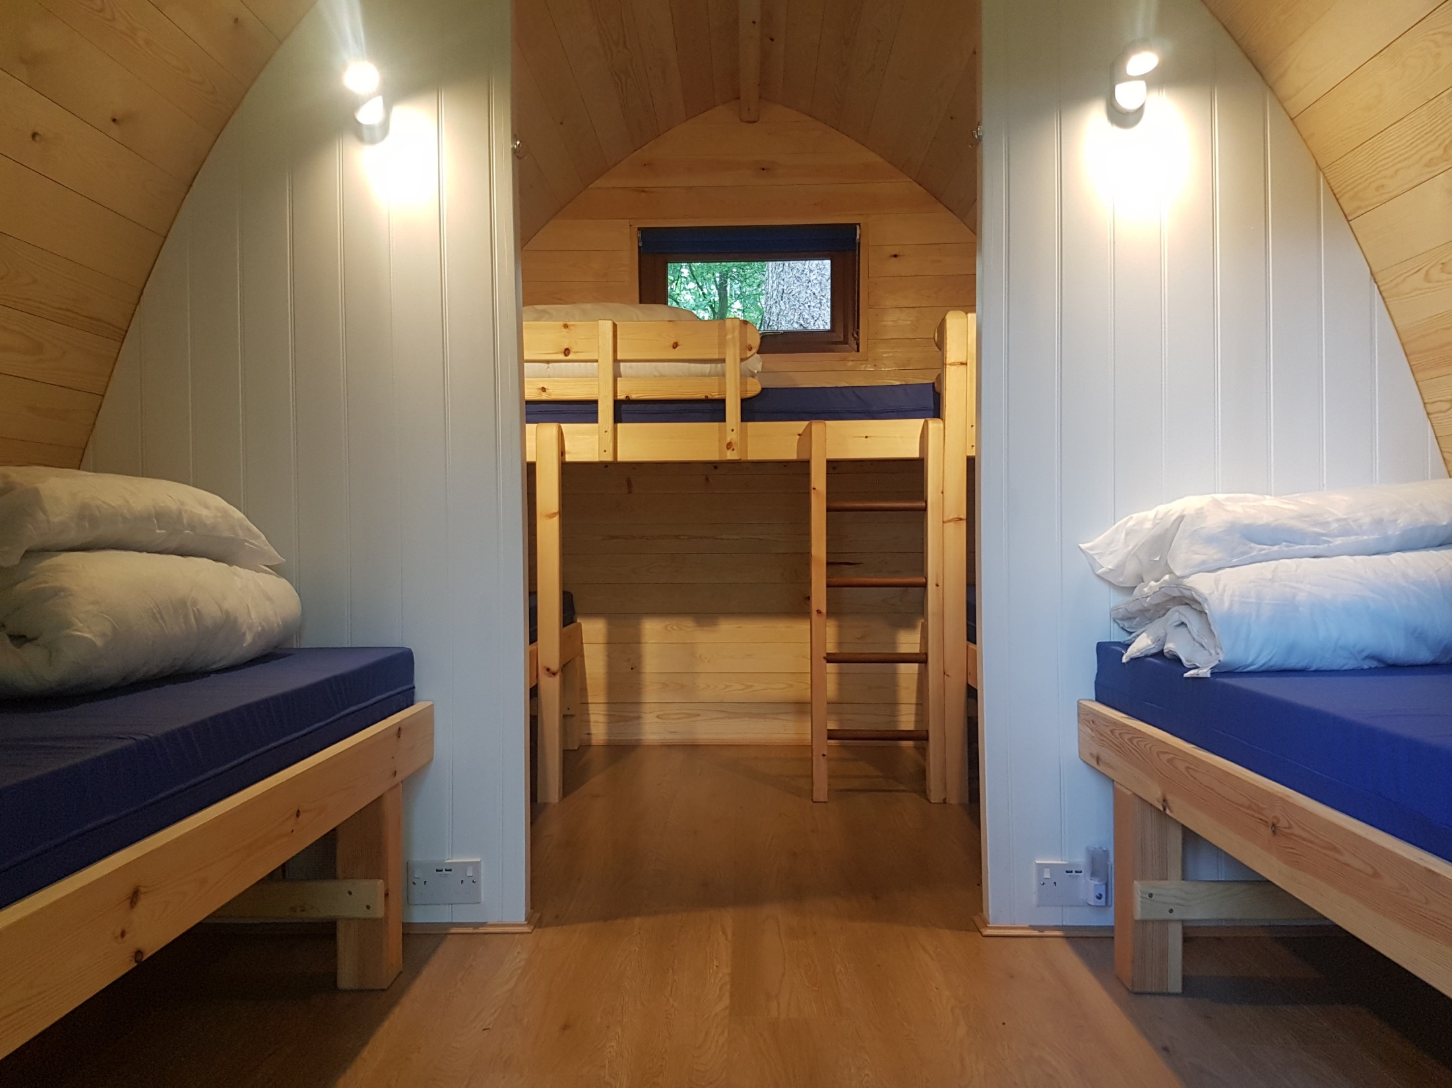

Slide 6
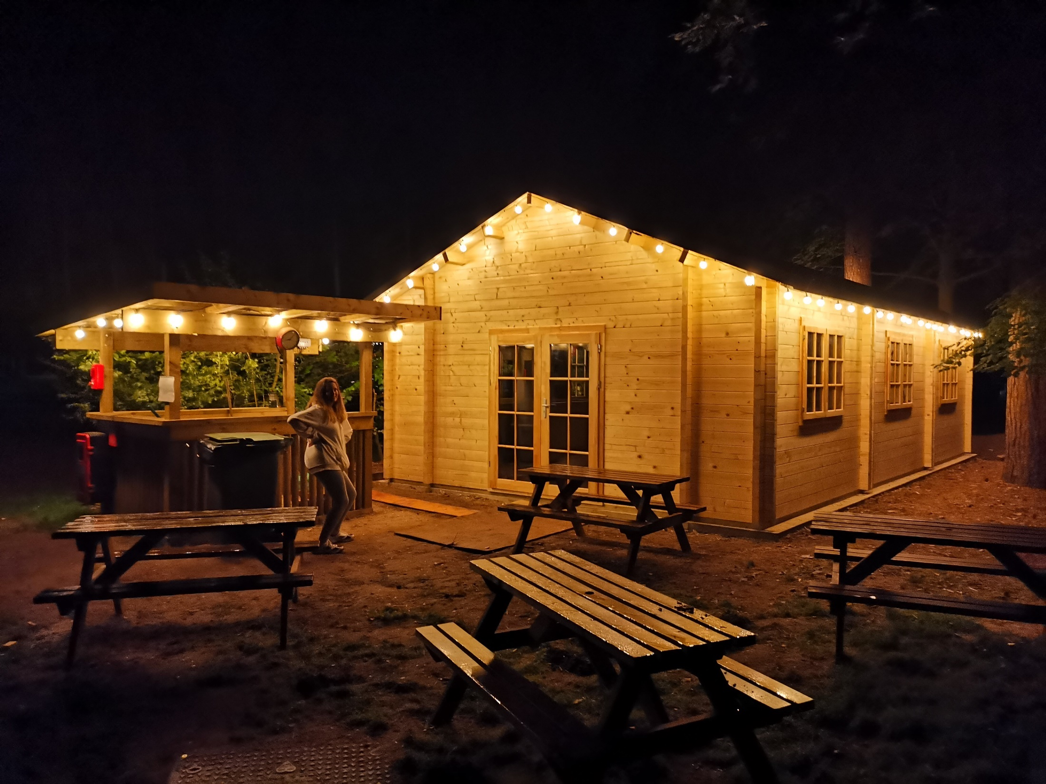

Slide 7
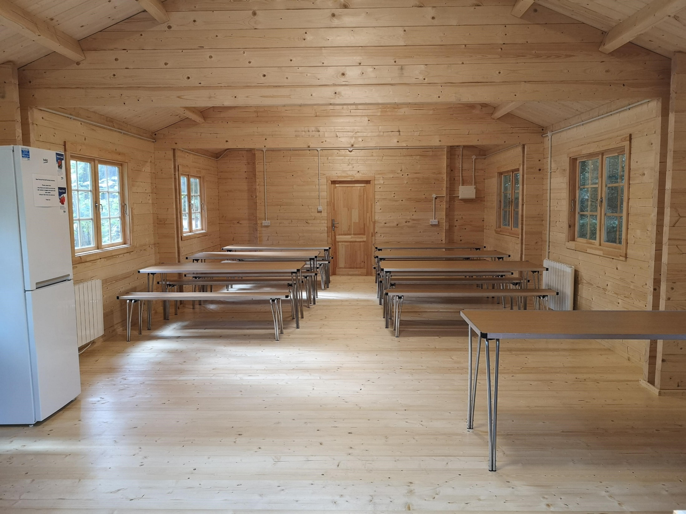

Slide 8
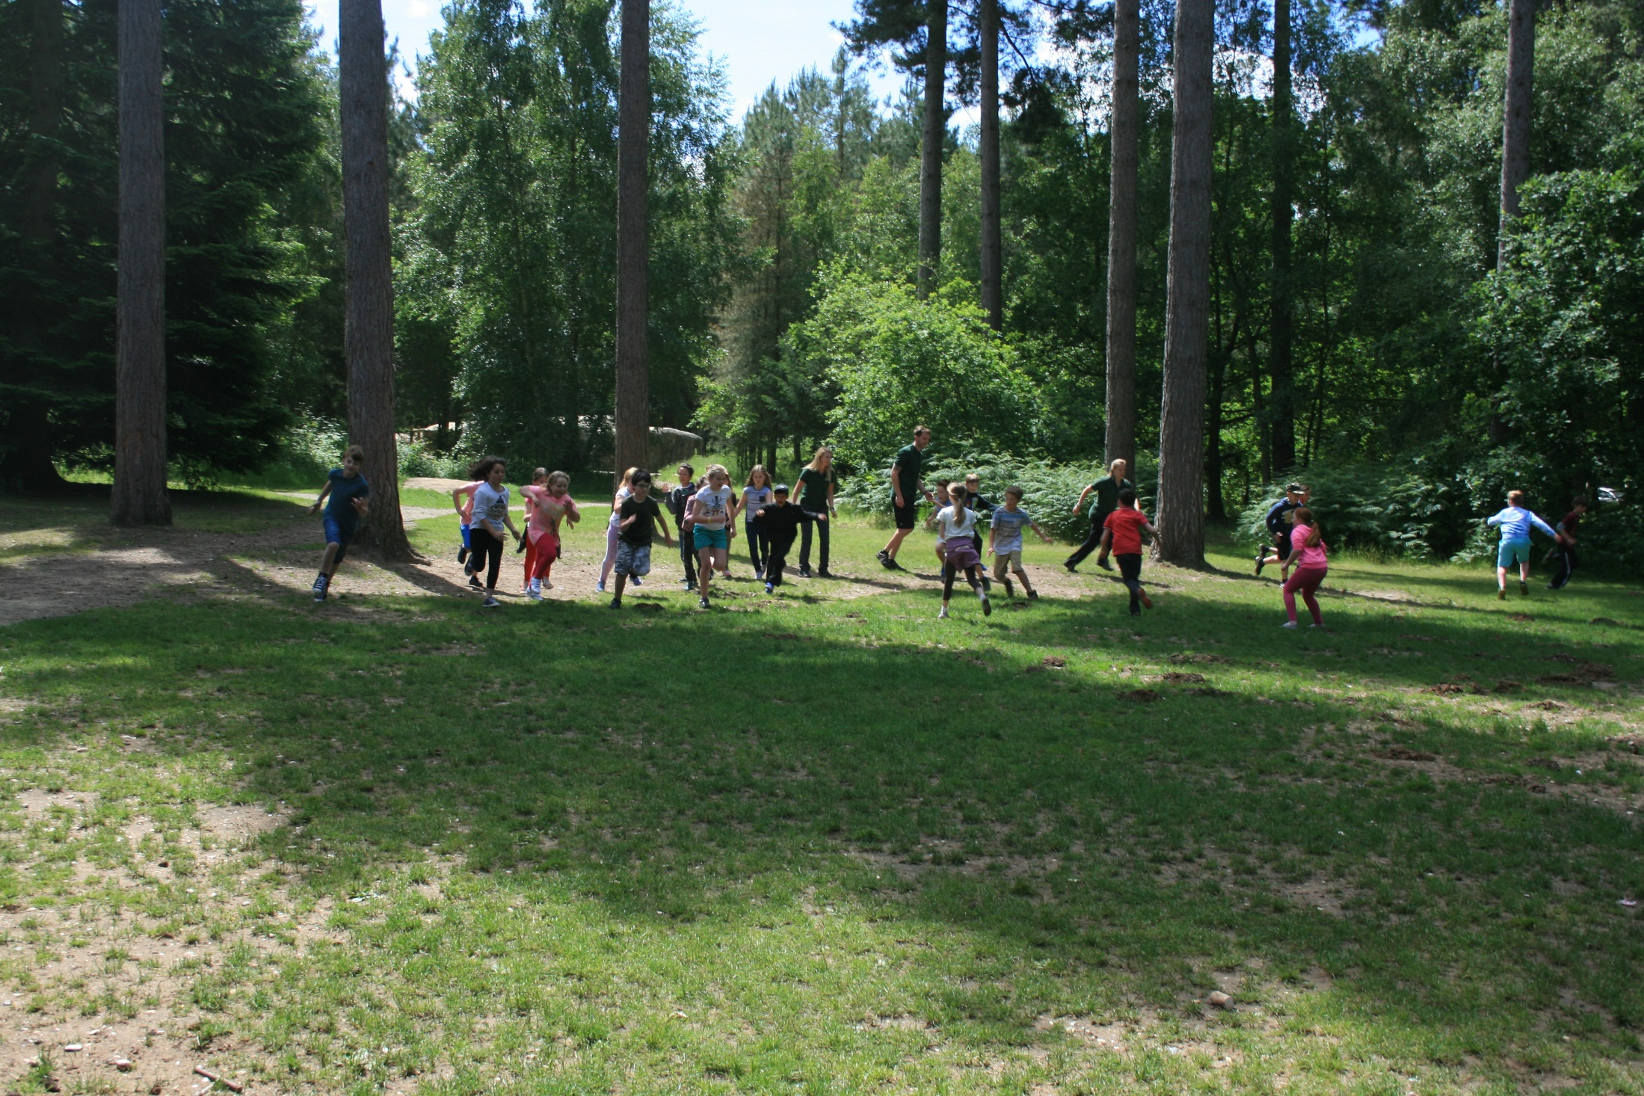

Slide 9
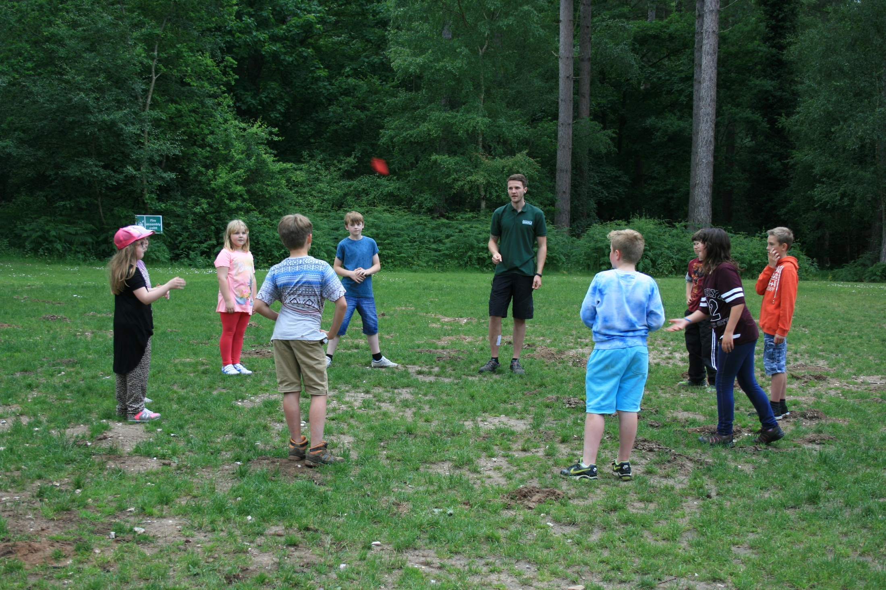

Slide 10
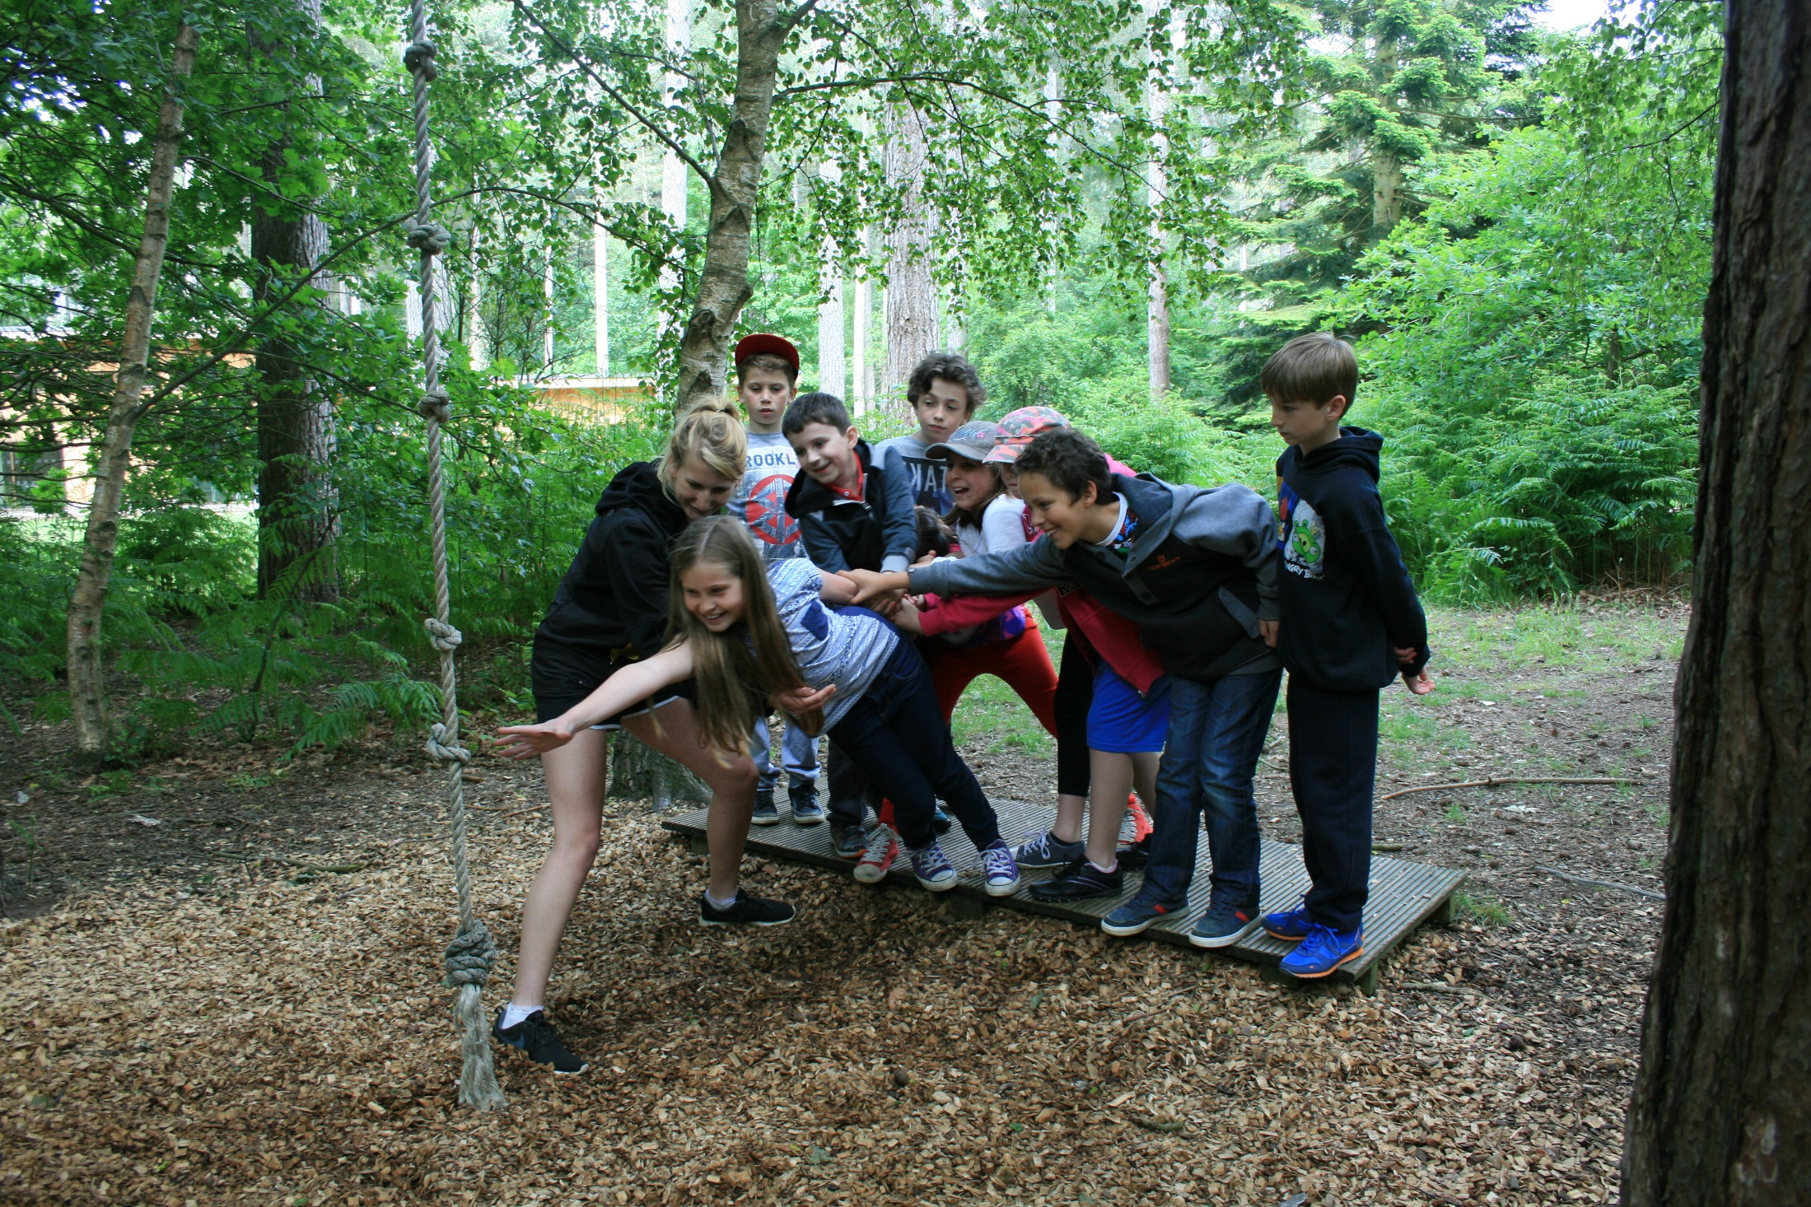

Slide 11
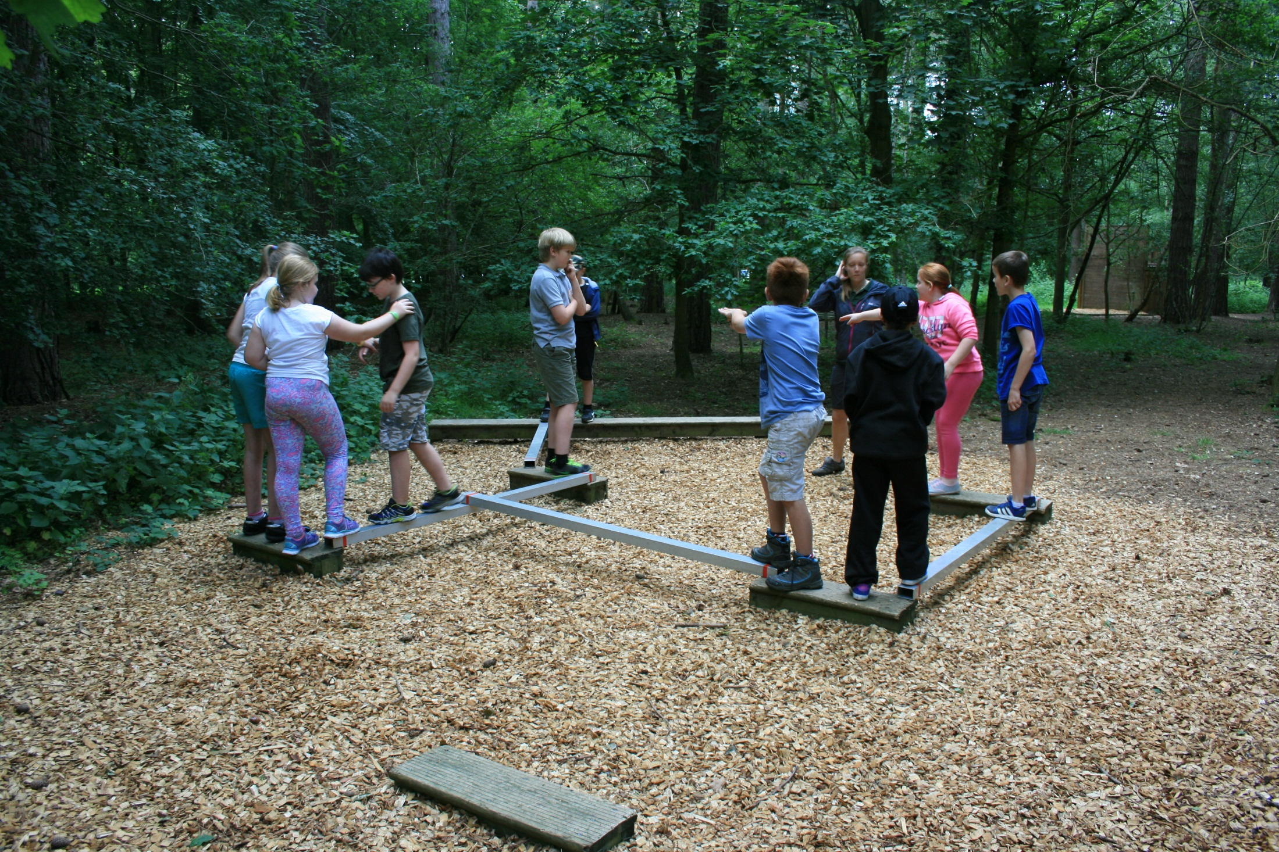

Slide 12
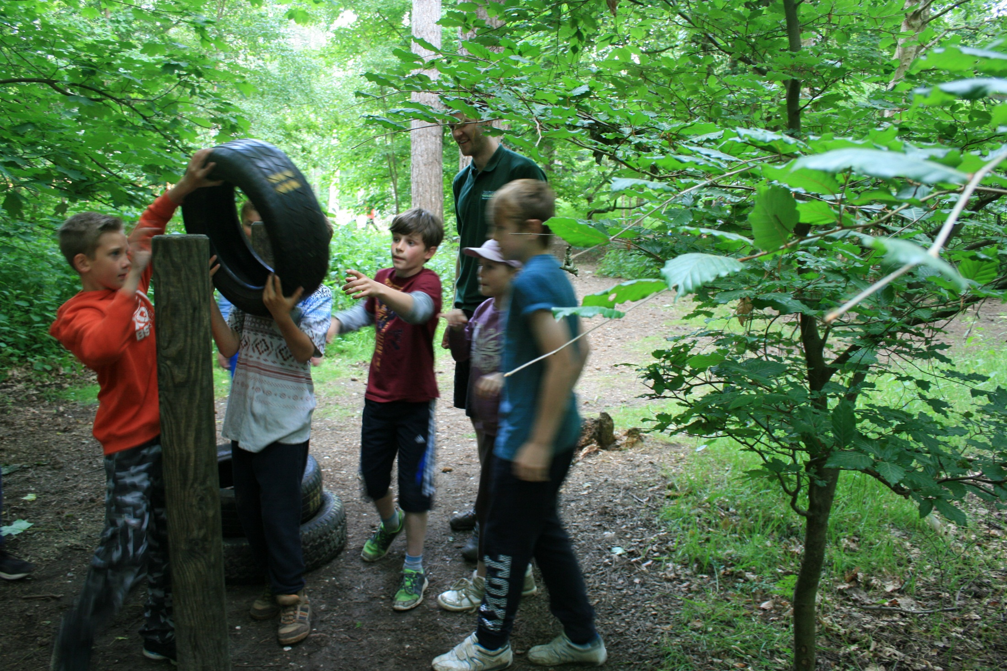

Slide 13
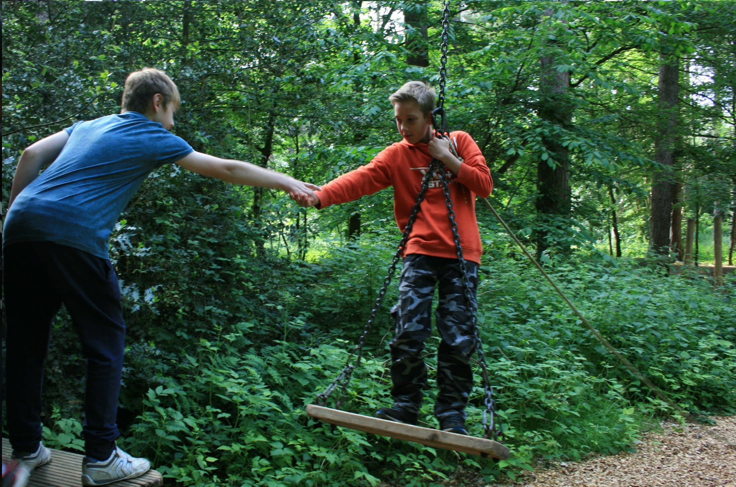

Slide 14
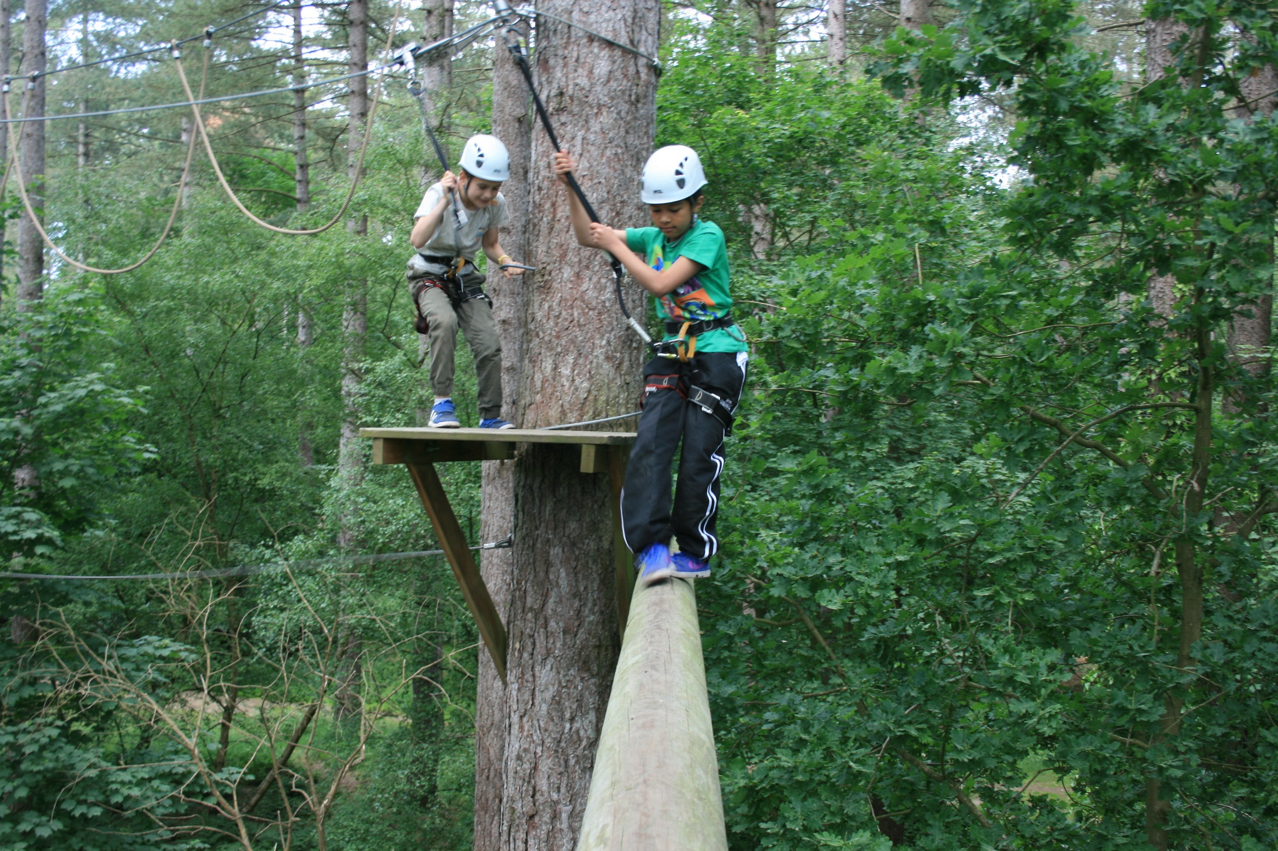

Slide 15
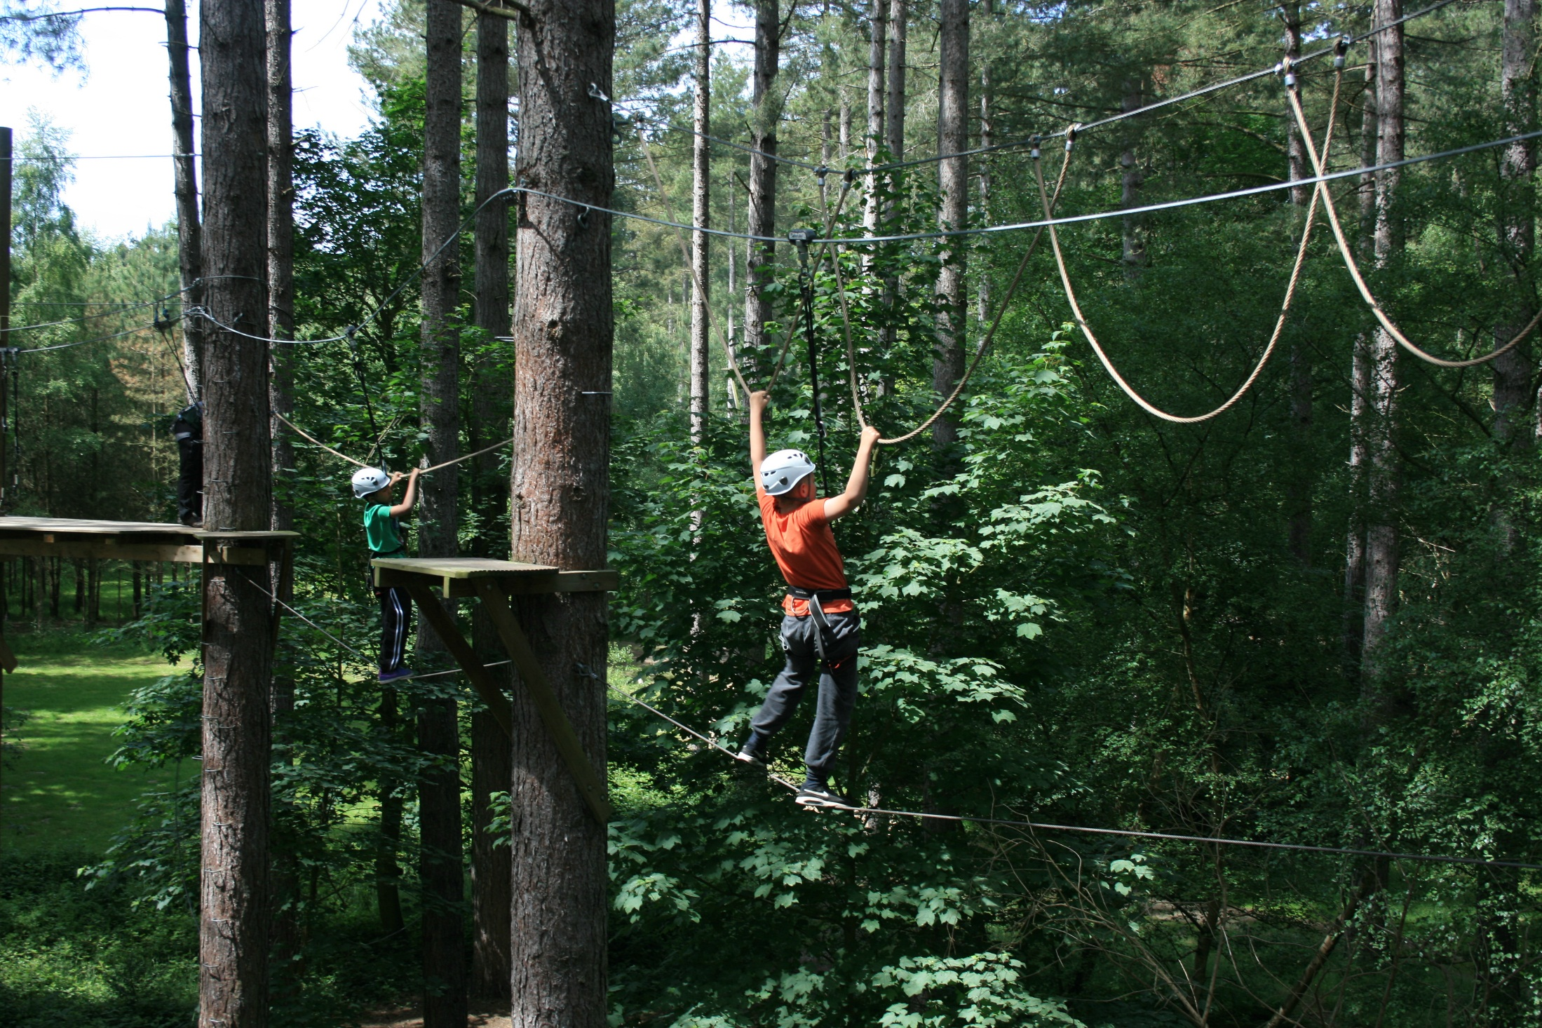

Slide 16
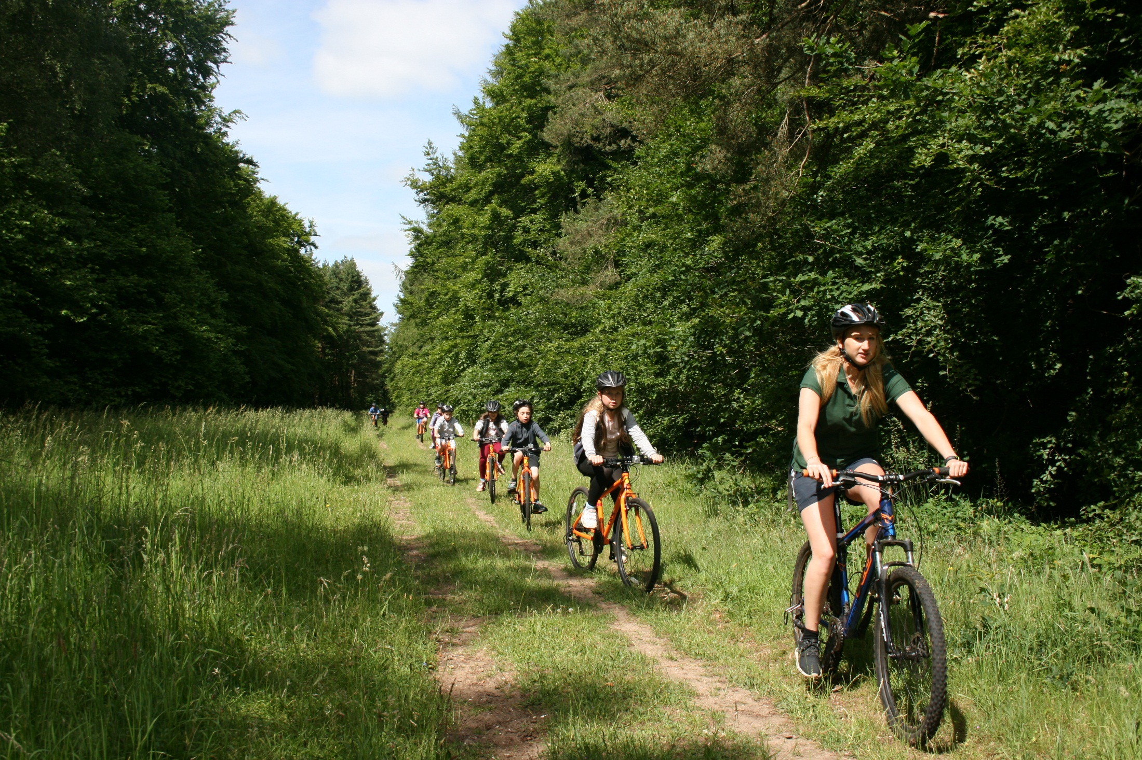

Slide 17
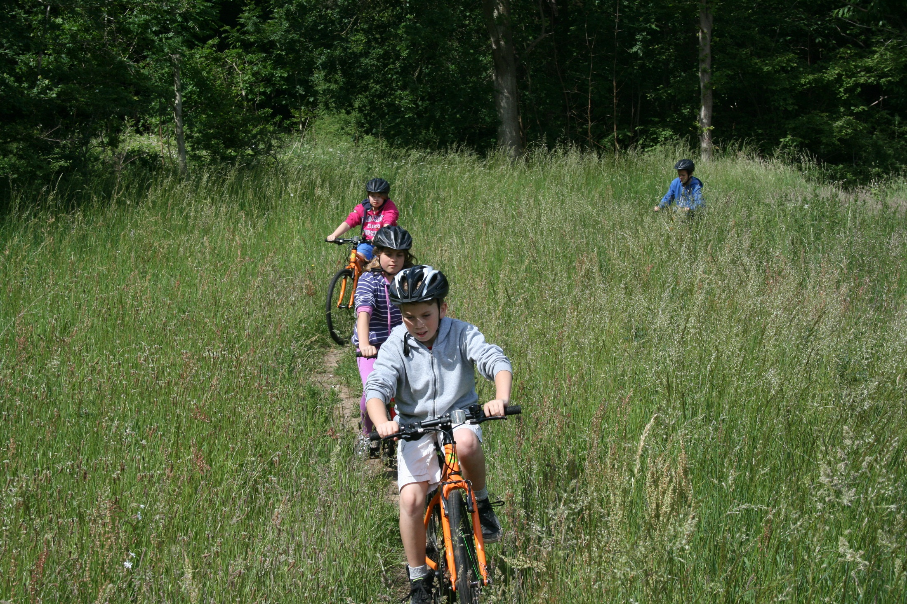

Slide 18
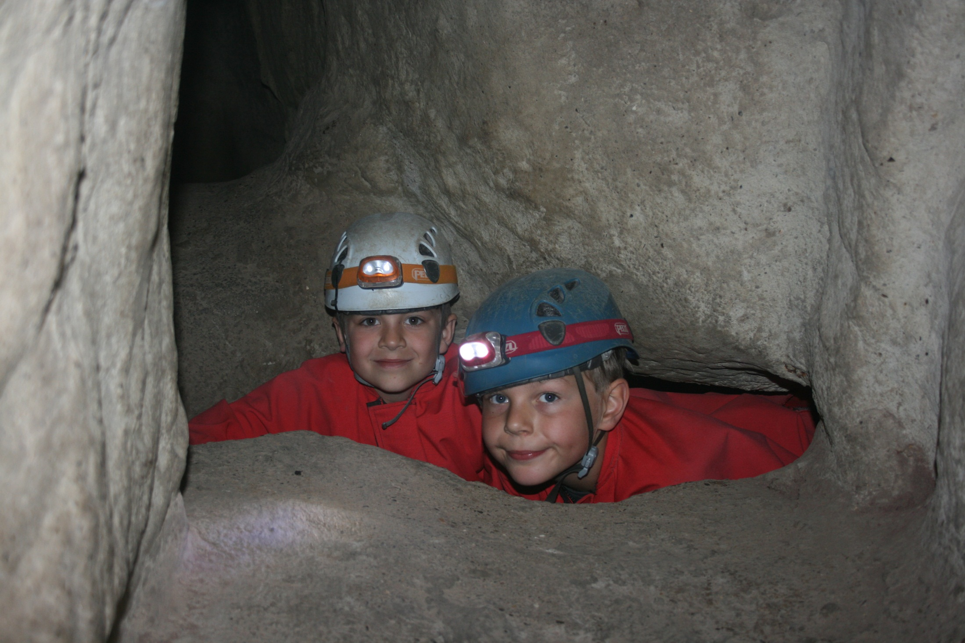

Slide 19
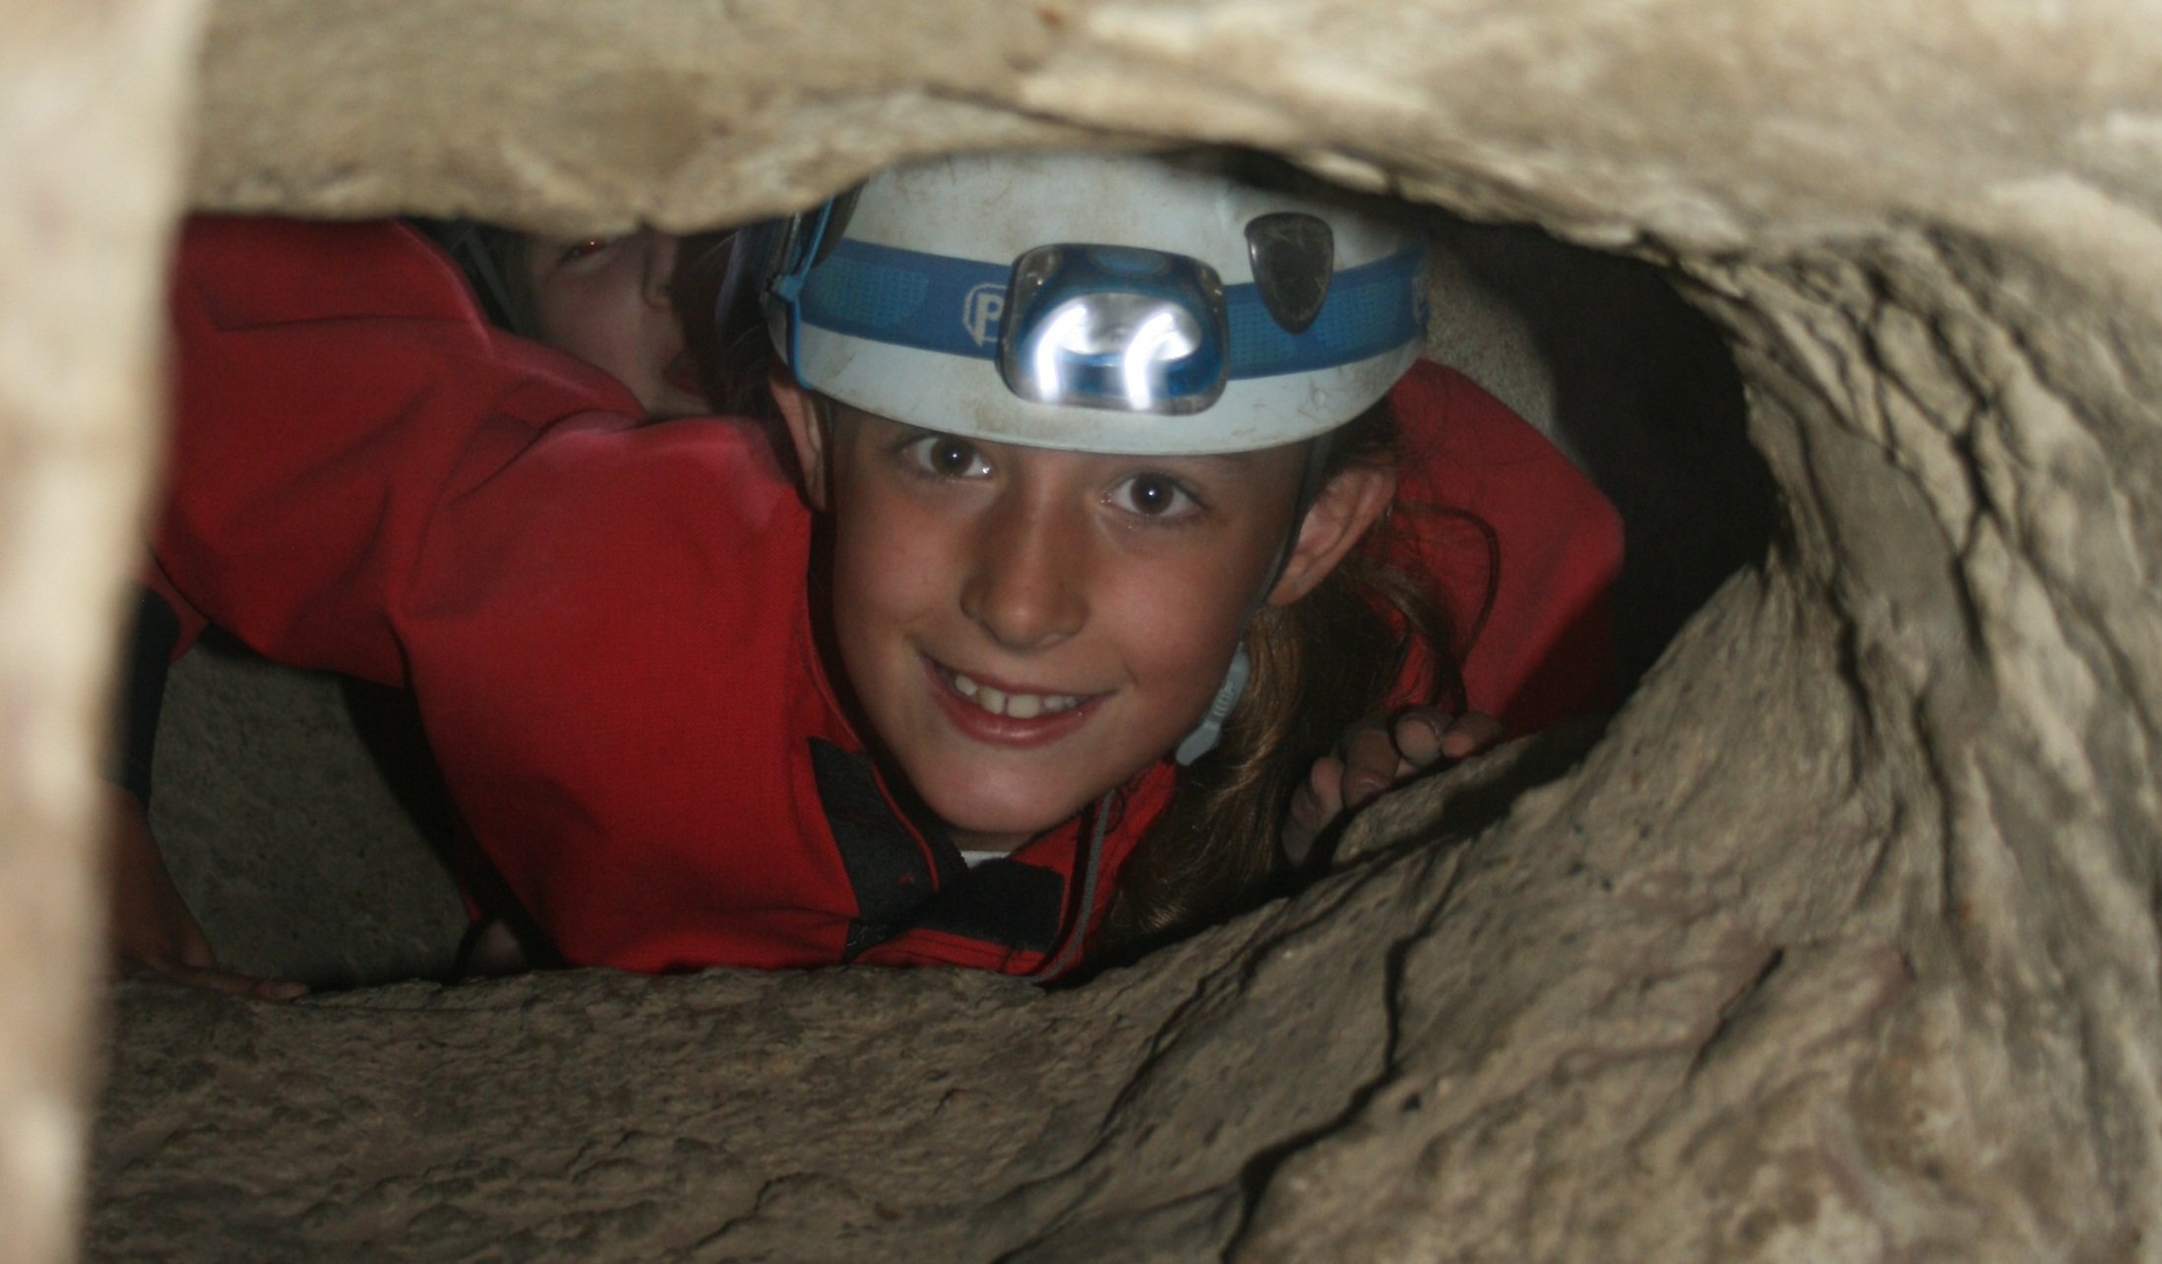

Slide 20
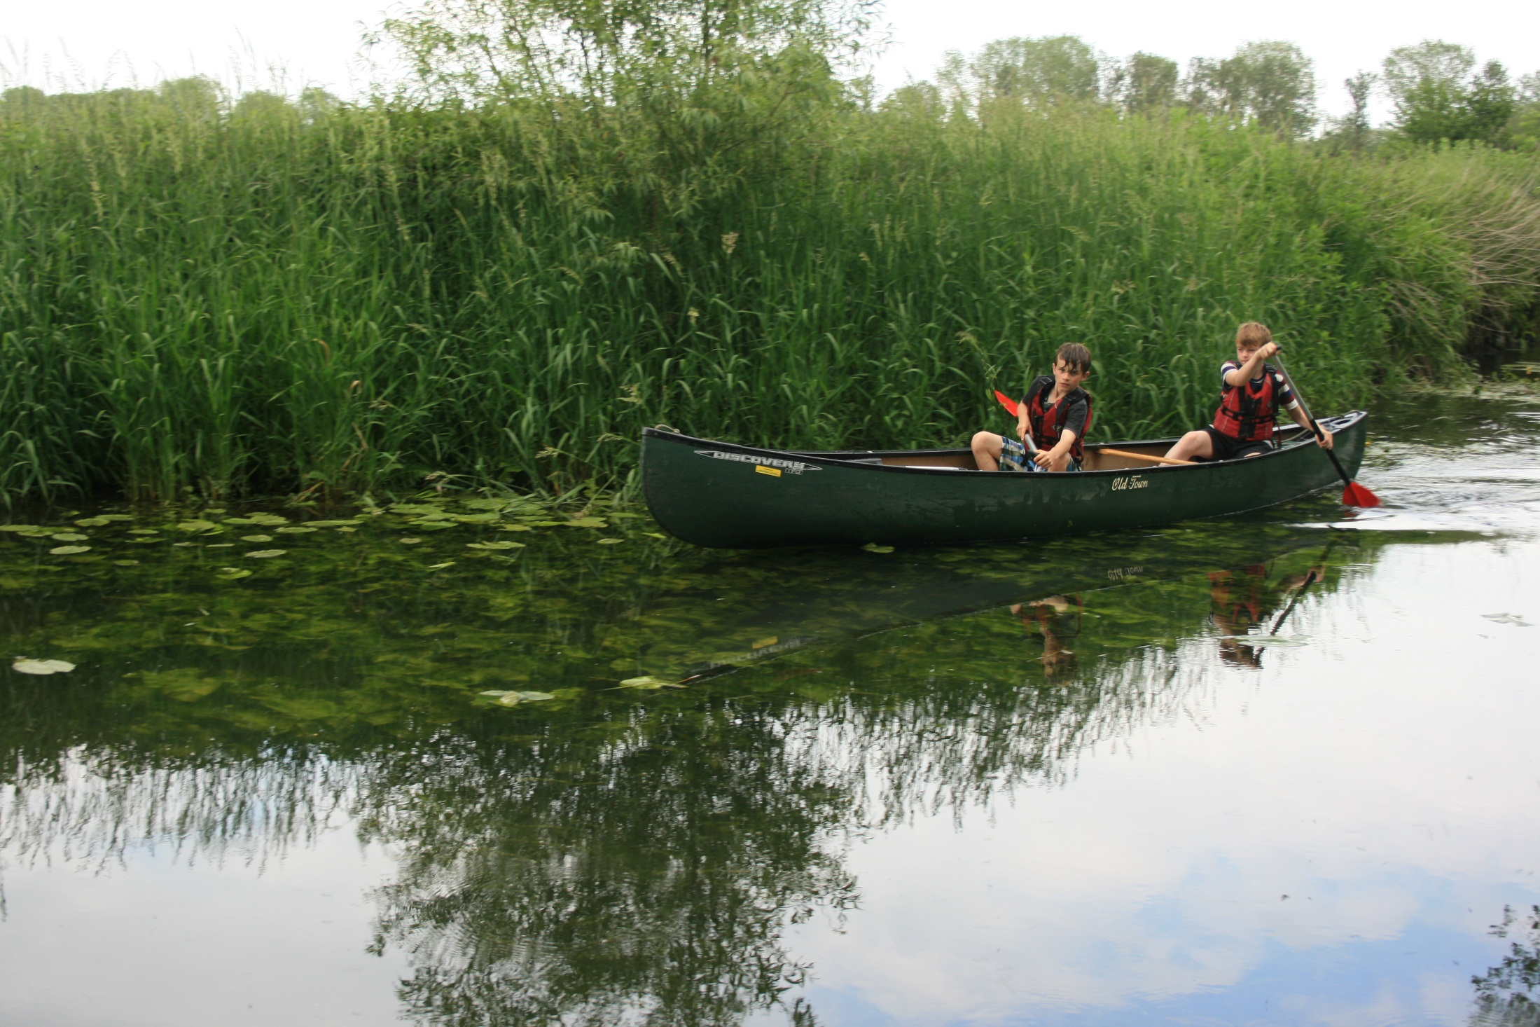

Slide 21
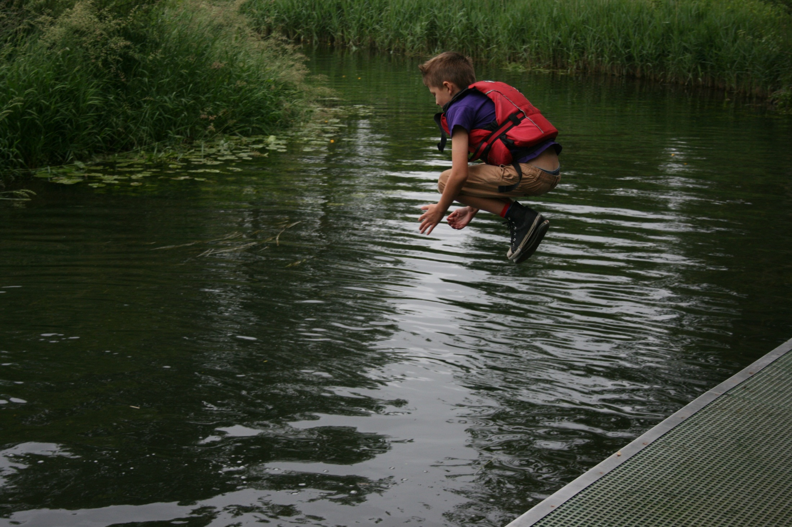

Slide 22
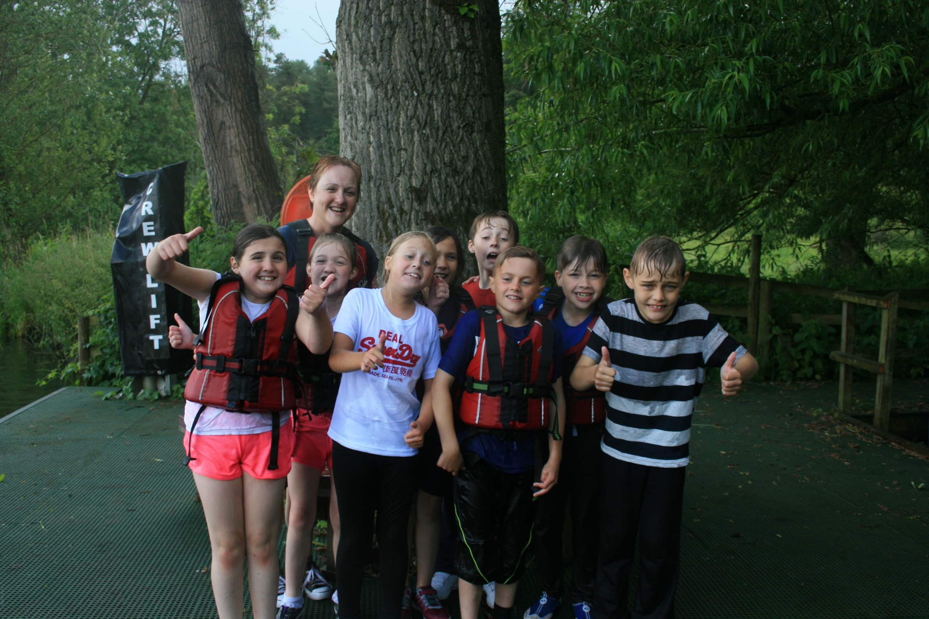

Slide 23
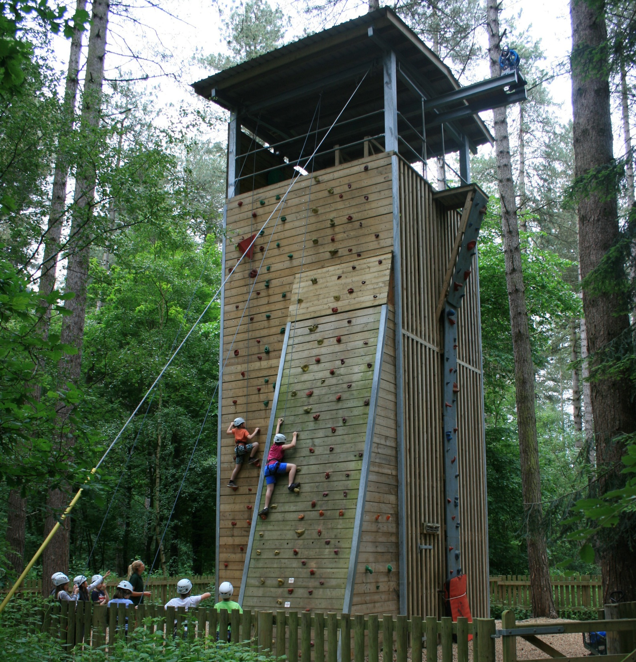

Slide 24
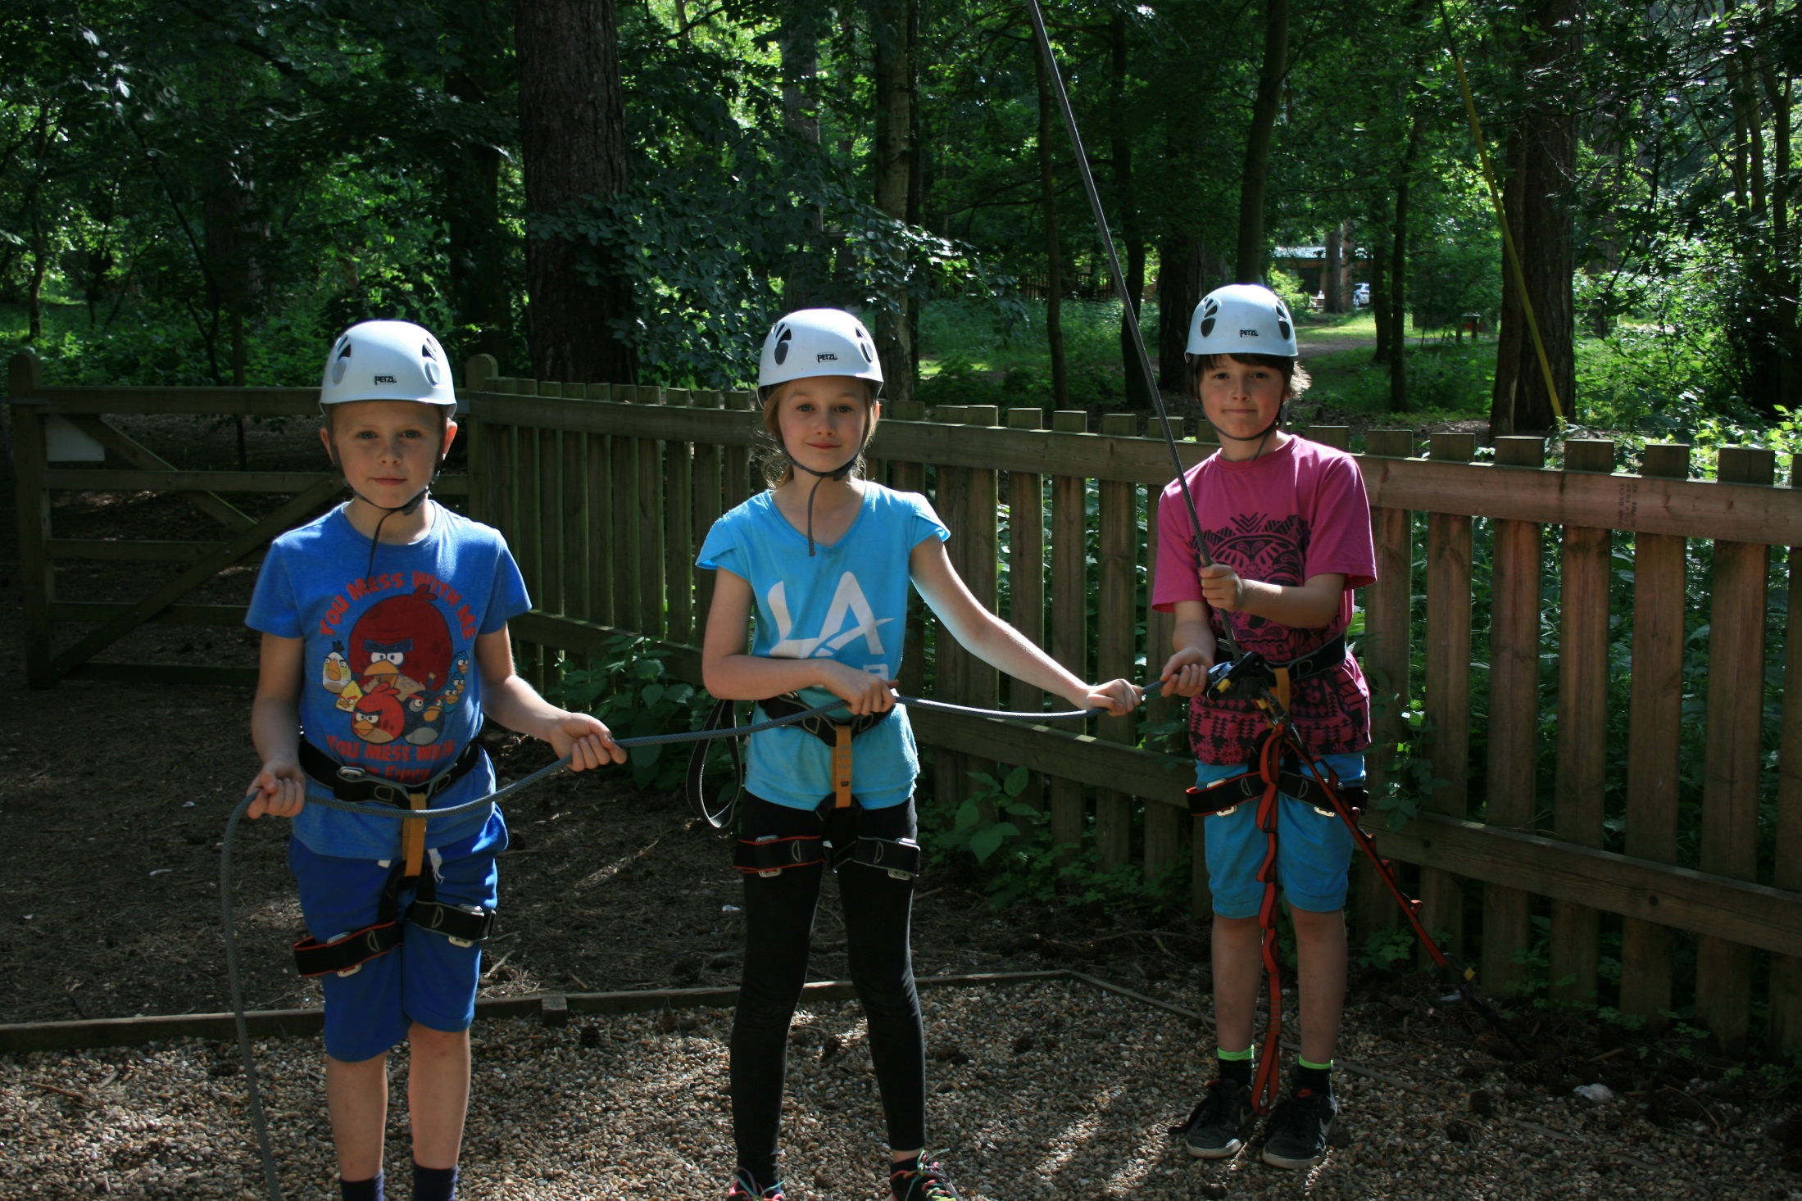

Slide 25
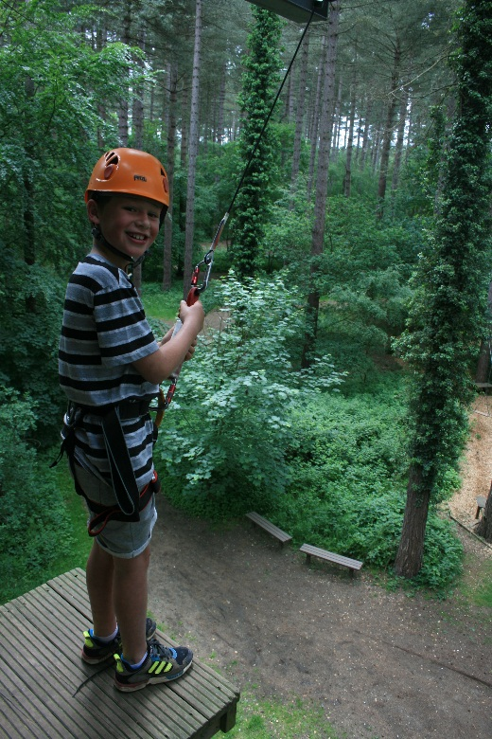
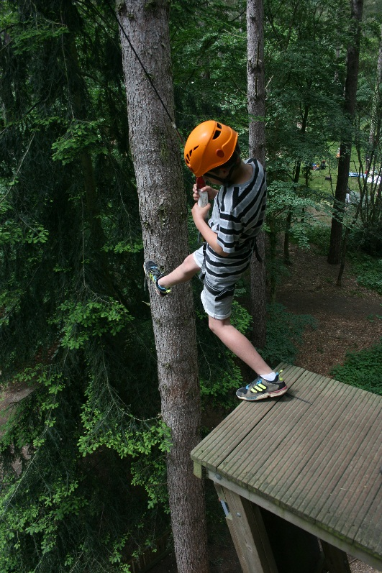
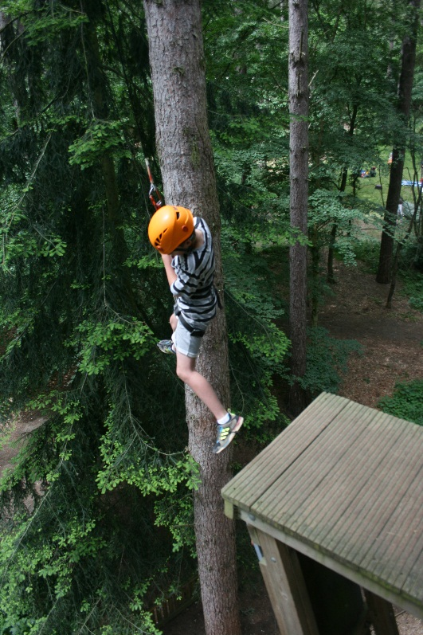

Slide 26
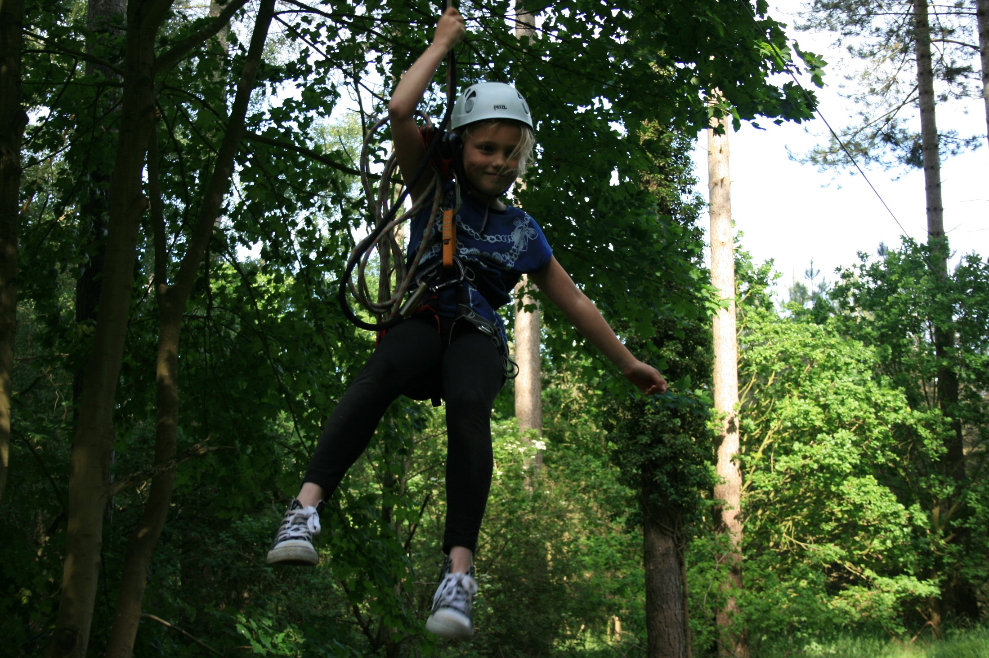

Slide 27
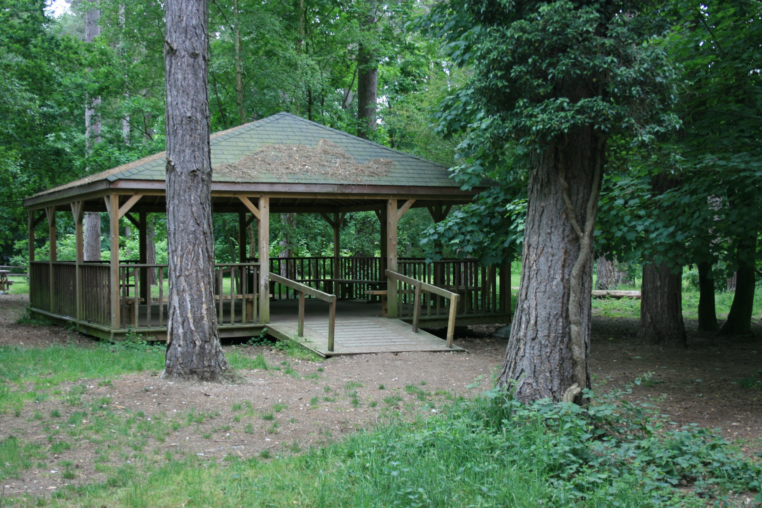

Slide 28
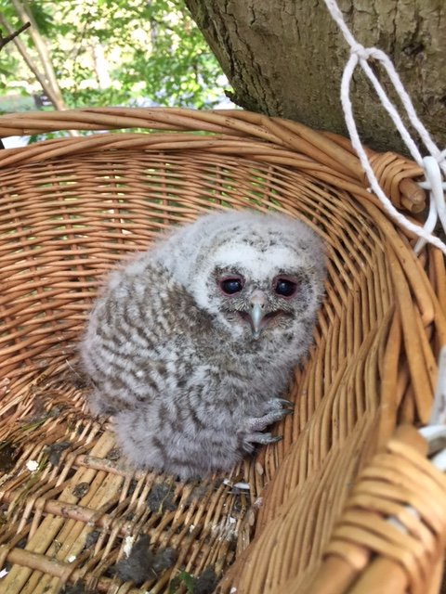
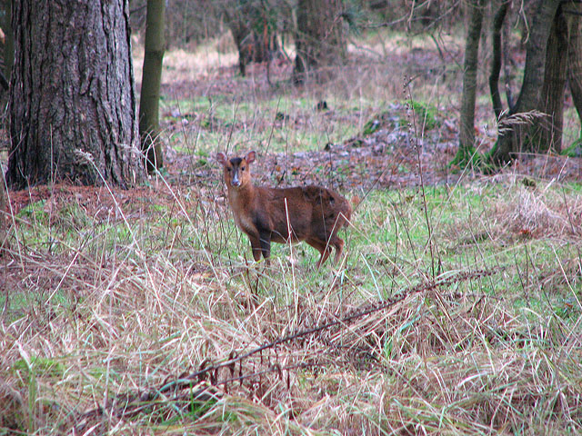
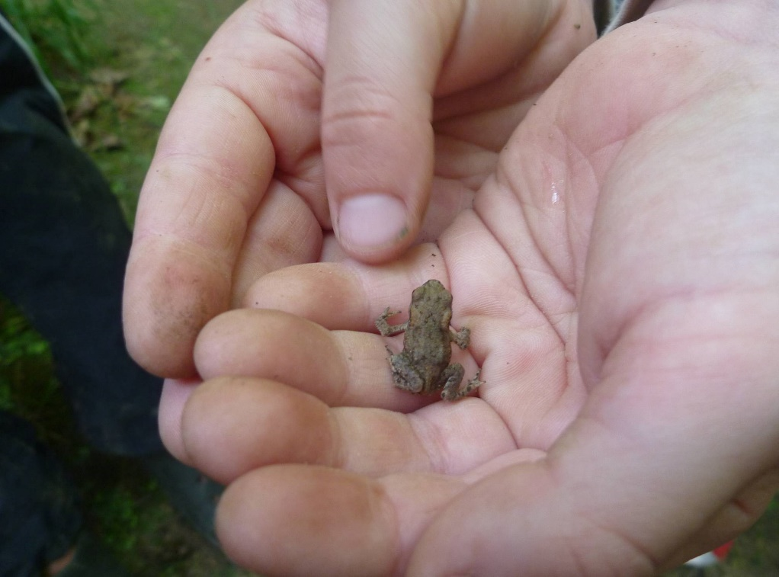
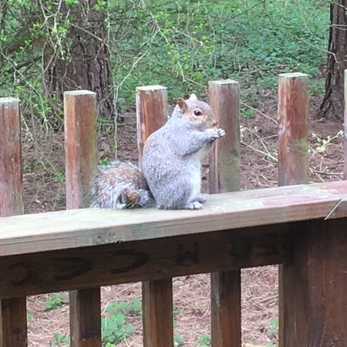

Slide 29
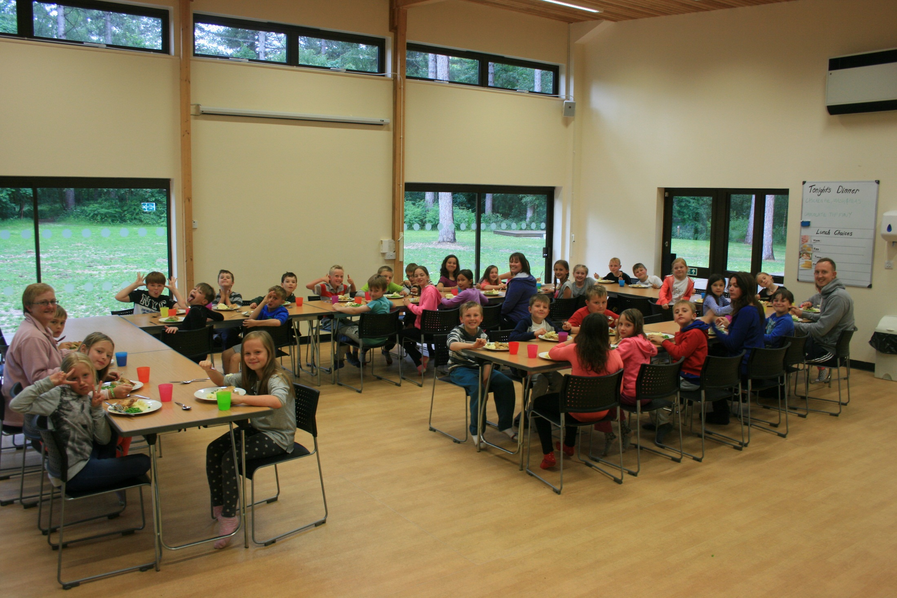

Slide 30
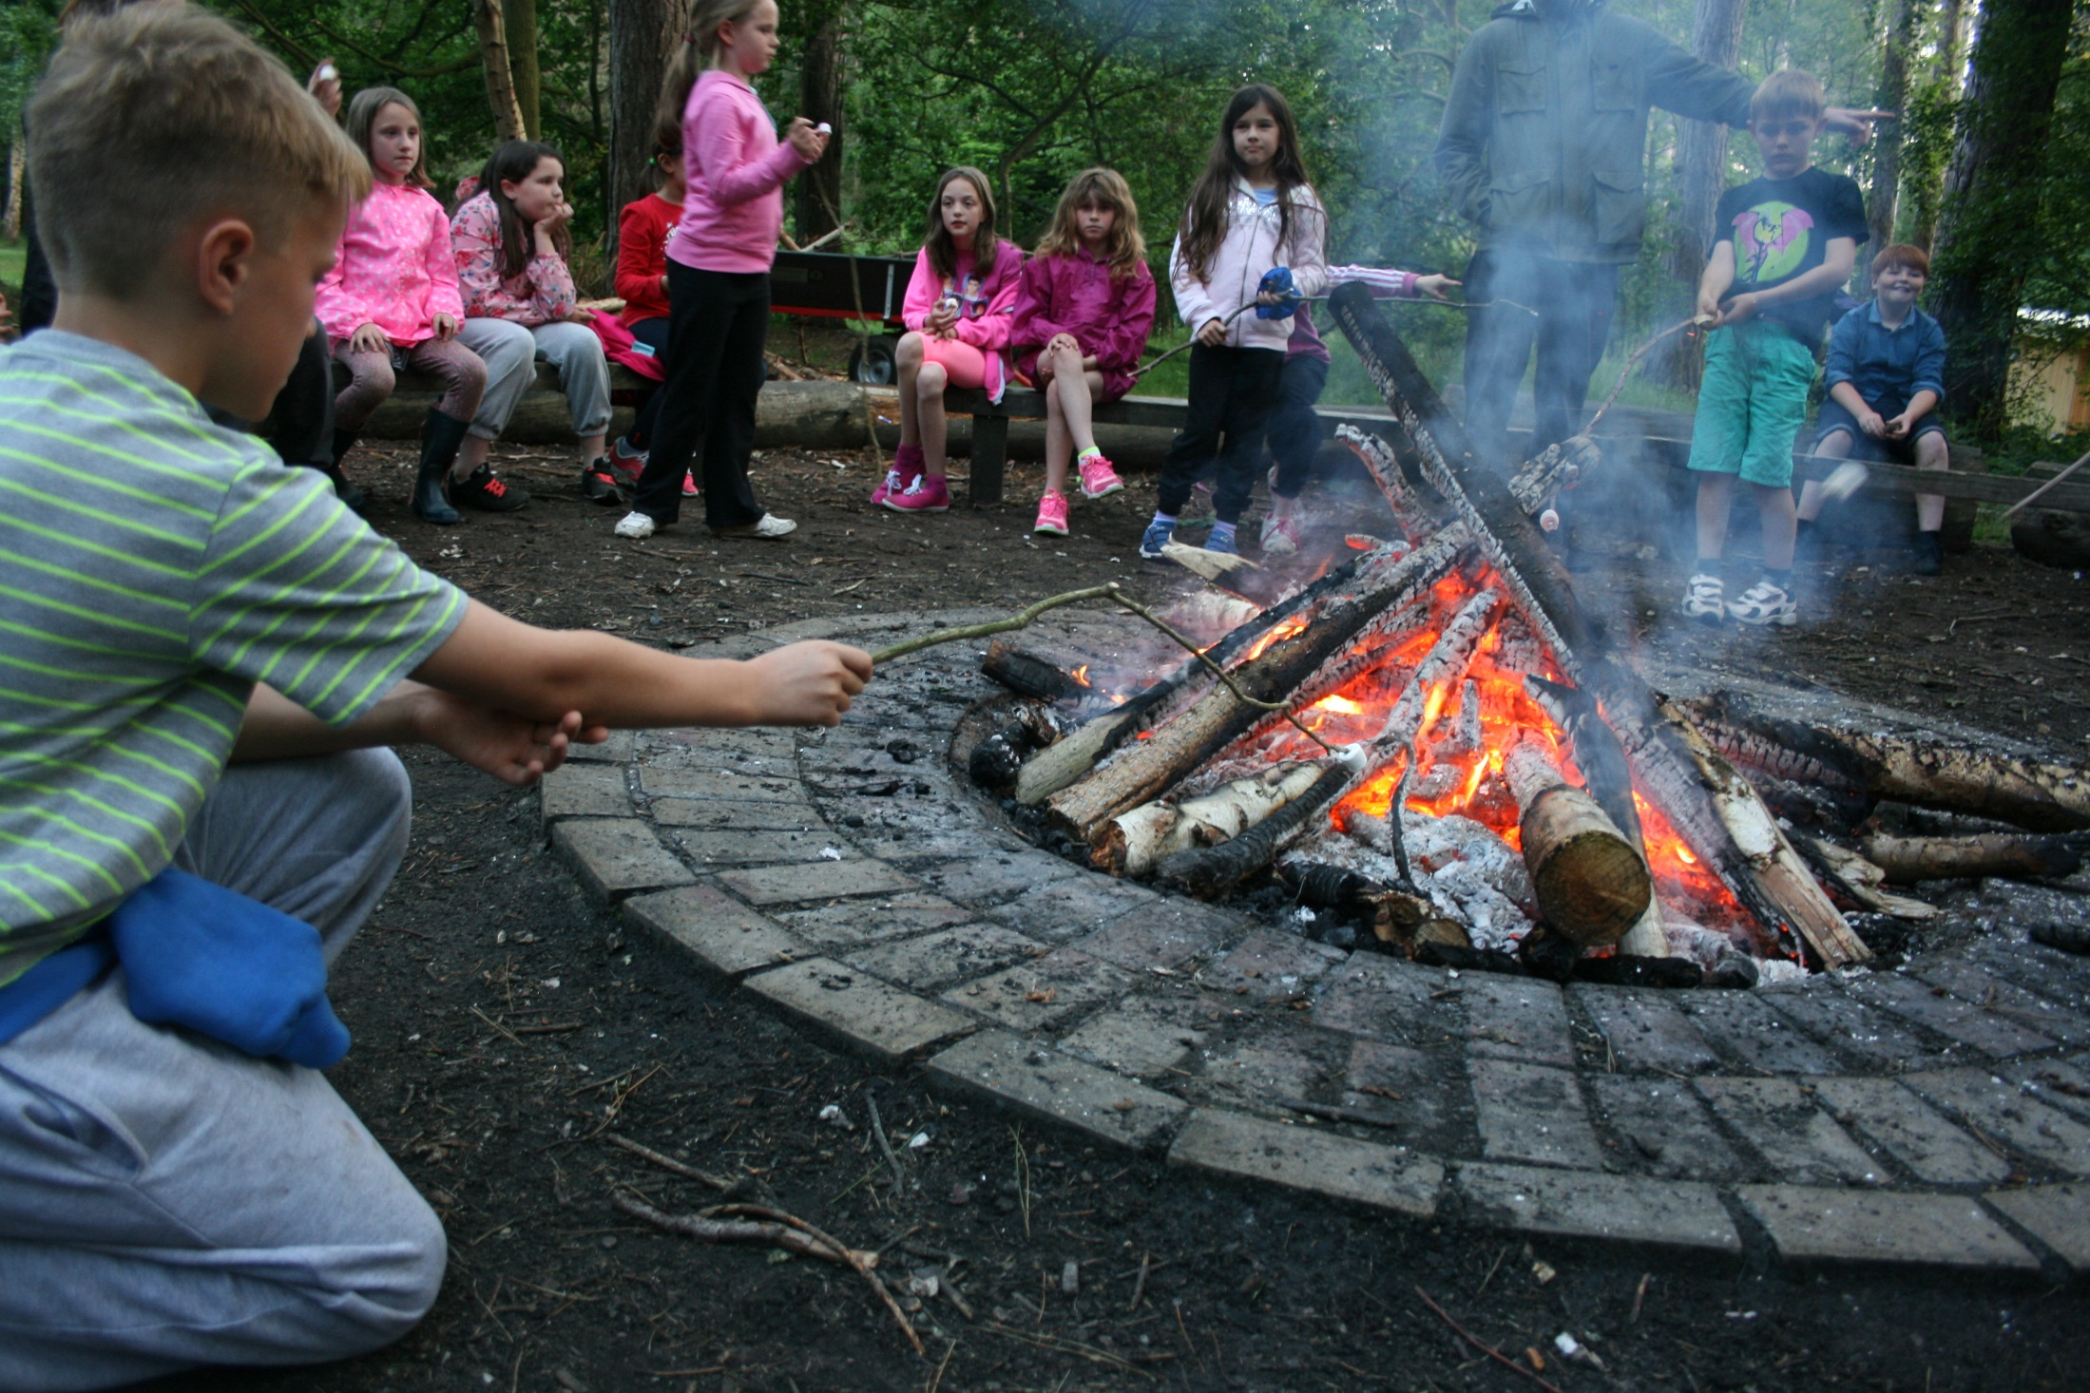

Slide 31
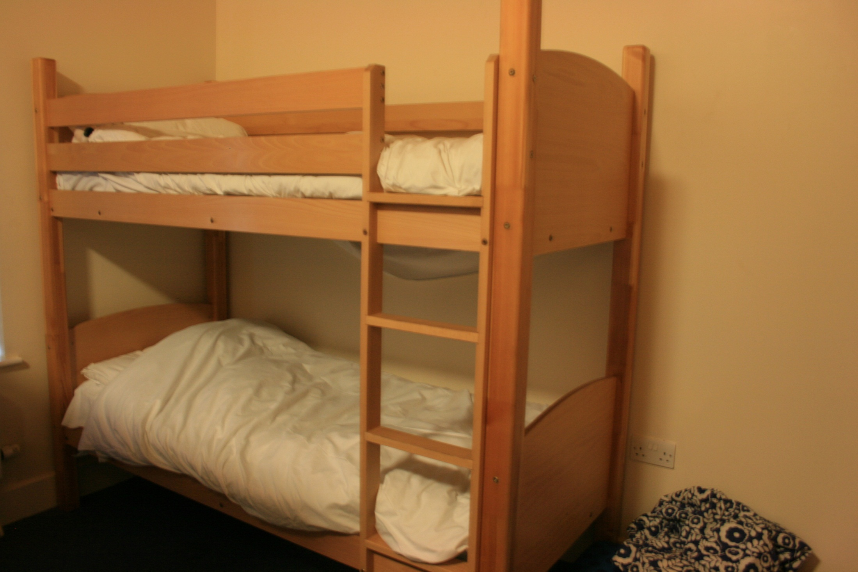

Slide 32
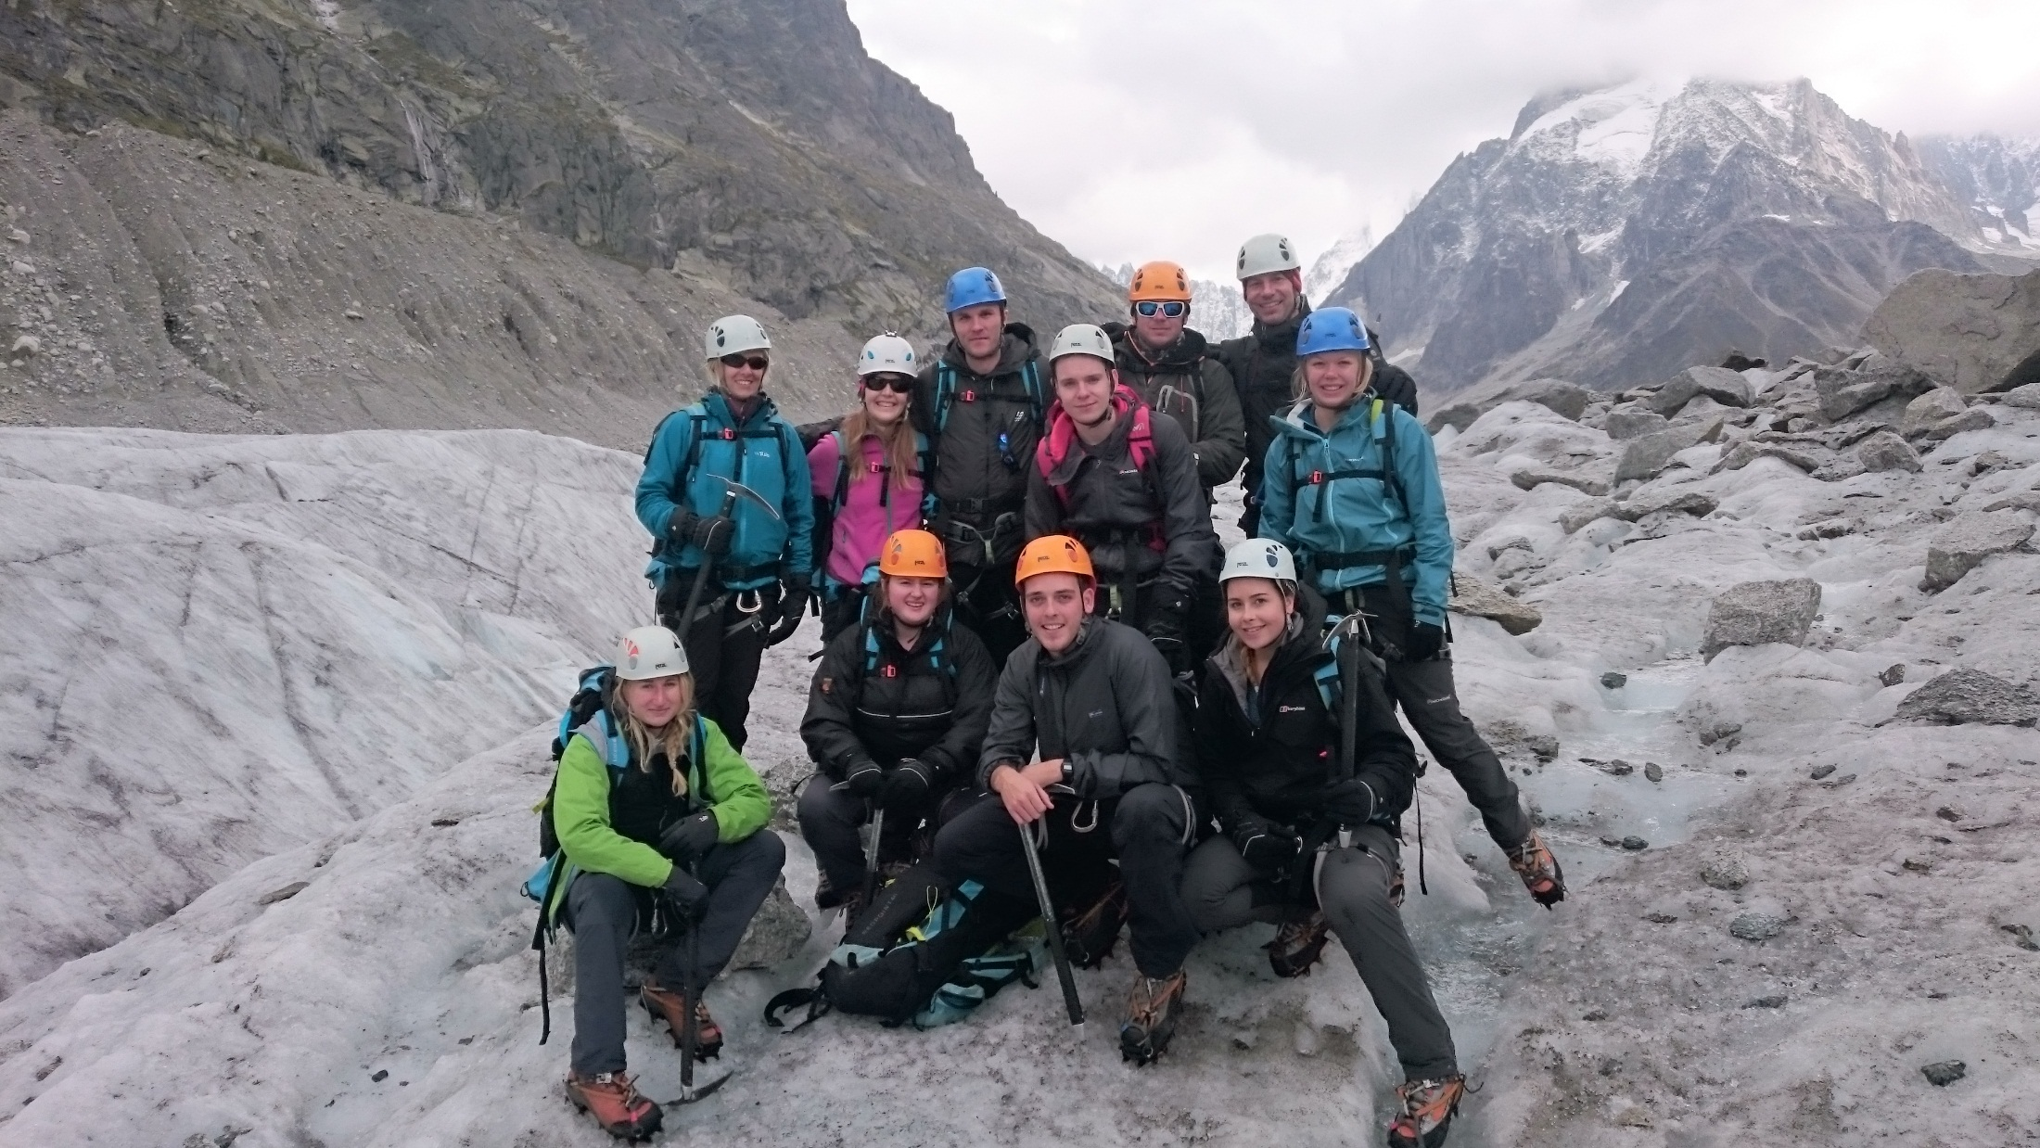

Slide 34

Example programme
–
3 day primary school residential
 | 9 - 9.30am | 9.30 – 12pm | 12 – 1pm | 1 – 3pm | 3 – 5pm | 5 – 7pm | 7pm-9pm
Mon | - | Welcome briefing and Energisers Arrive at 10am | Lunch | Team Challenges | Archery/Caving (1) Climbing (2) Canoeing (3) | Free Time and Dinner (6pm) | Campfire and evening activities
Tues | Energiser | Tree Trek (1) Canoeing (2) Climbing (3) | Lunch | Climbing (1) Archery/Caving (2) Zip Wire (3) | Canoeing (1) Zip Wire (2) Tree Trek (3) | Free Time and Dinner (6pm) | Campfire and evening activities
Wed | Energiser | Zip Wire (1) Tree Trek (2) Archery/Caving (3) | Lunch | Shelter Building (Everyone) | Group Debrief & Home Time 3pm | - | -

